Slide 1
AI 활용 특강 Stable Diffusion

Slide 2
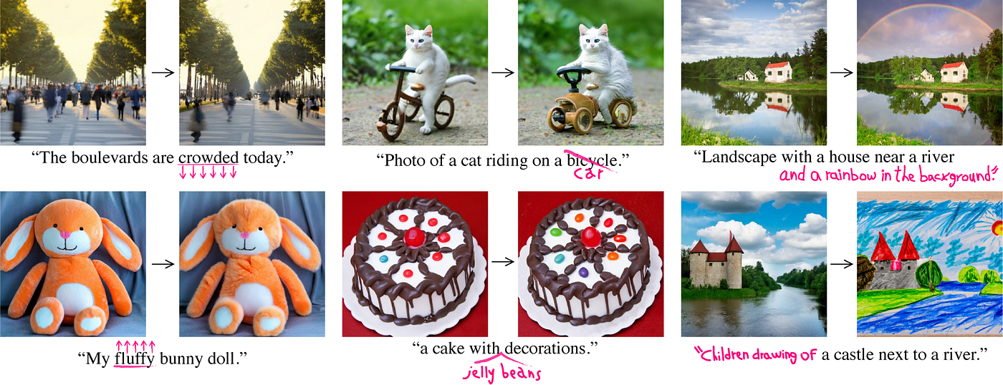
Image to Image

Slide 3
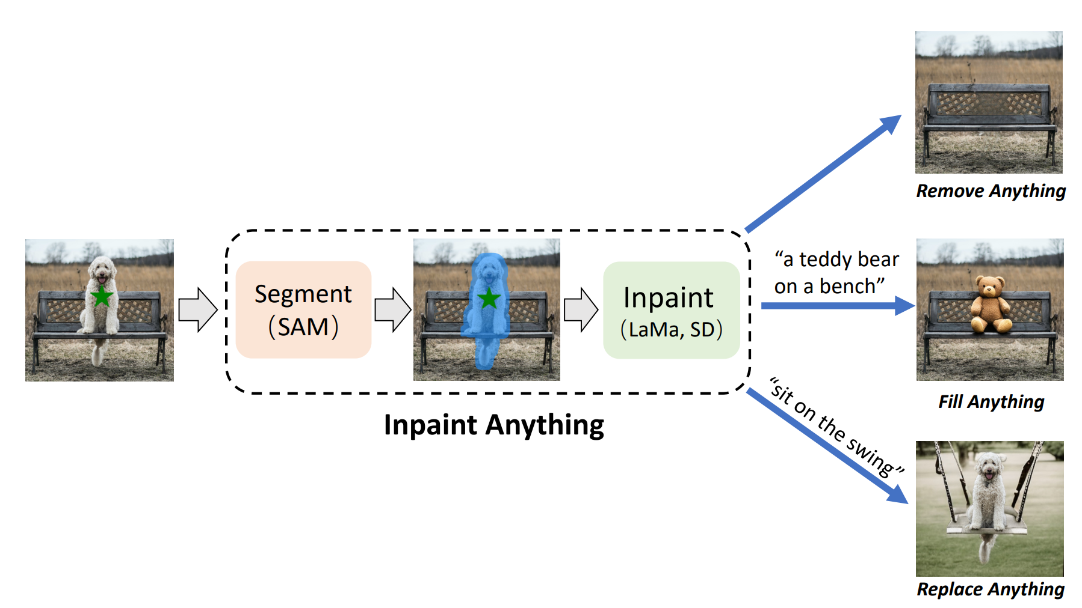
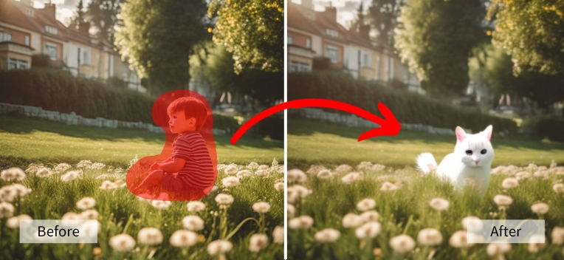
Image to Image - InPainting

Slide 4
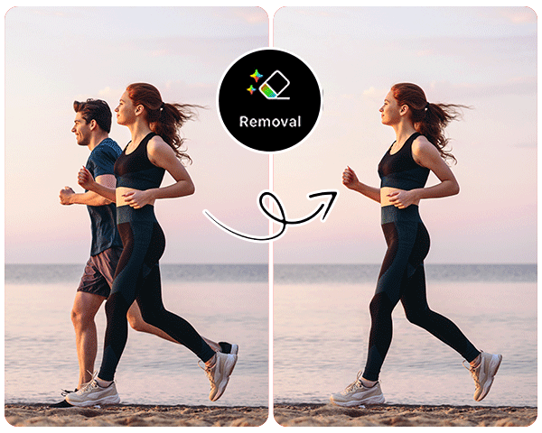
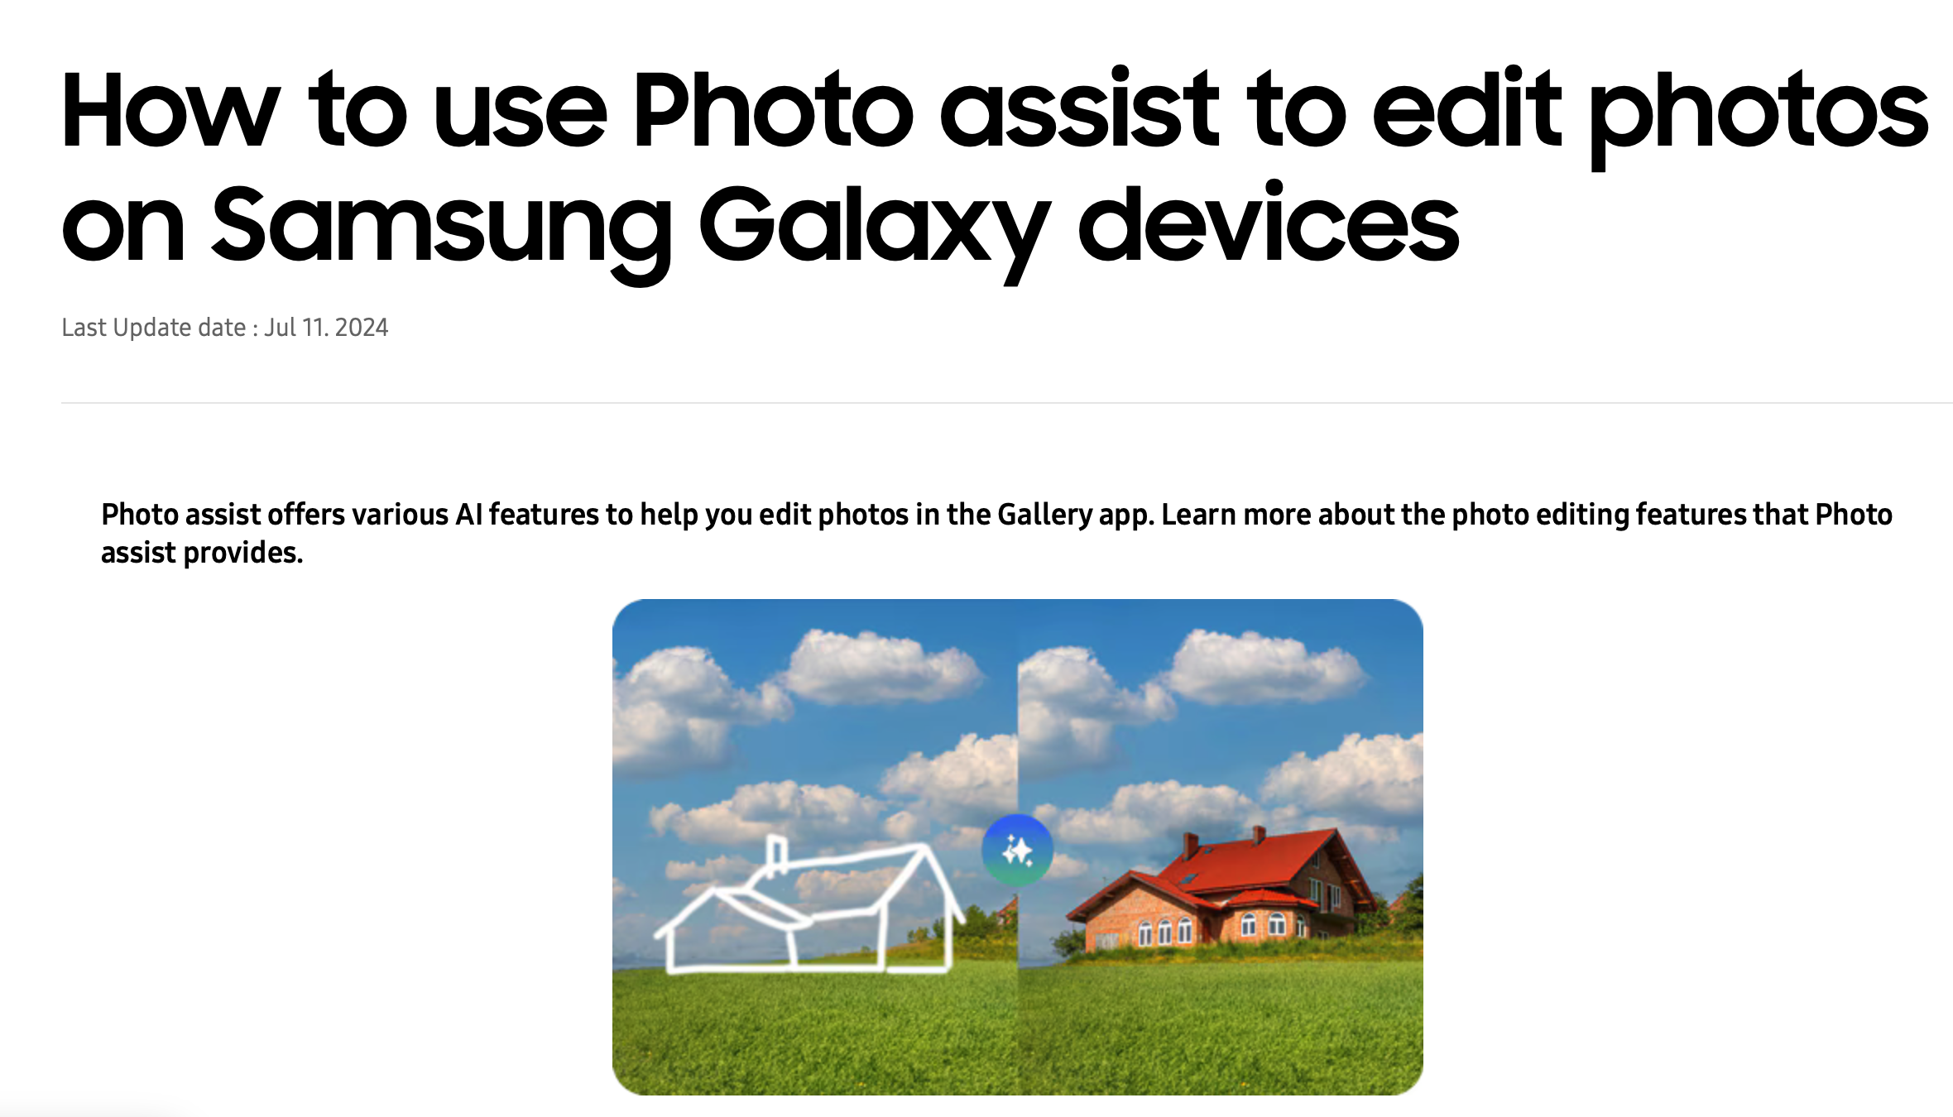
Image – InPainting (feat. Samsung)

Slide 5
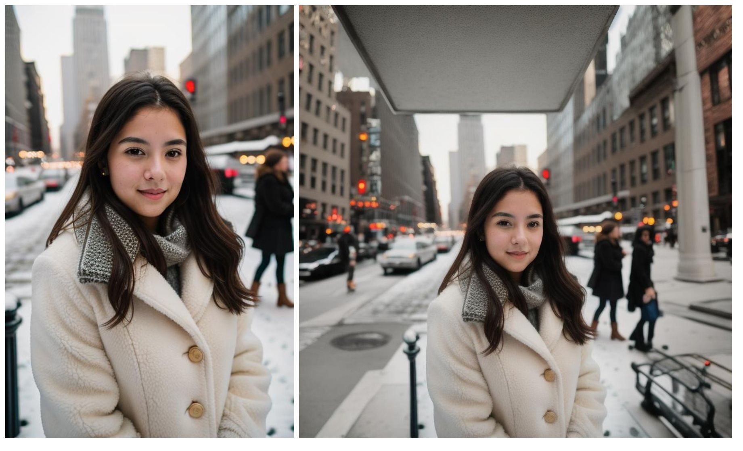
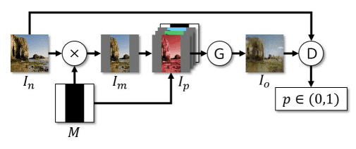
Image to Image - OutPainting

Slide 6
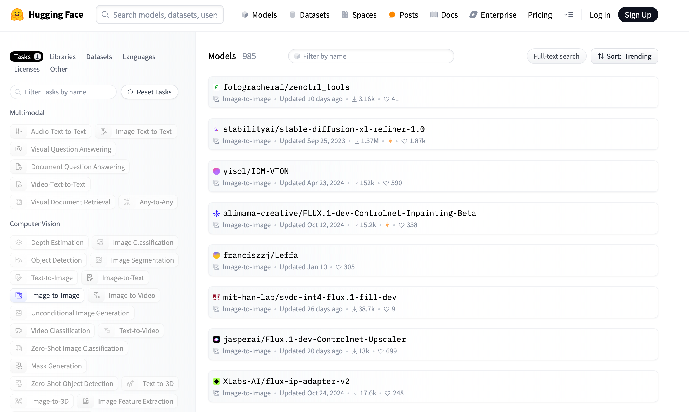
Image to Image etc…

Slide 7
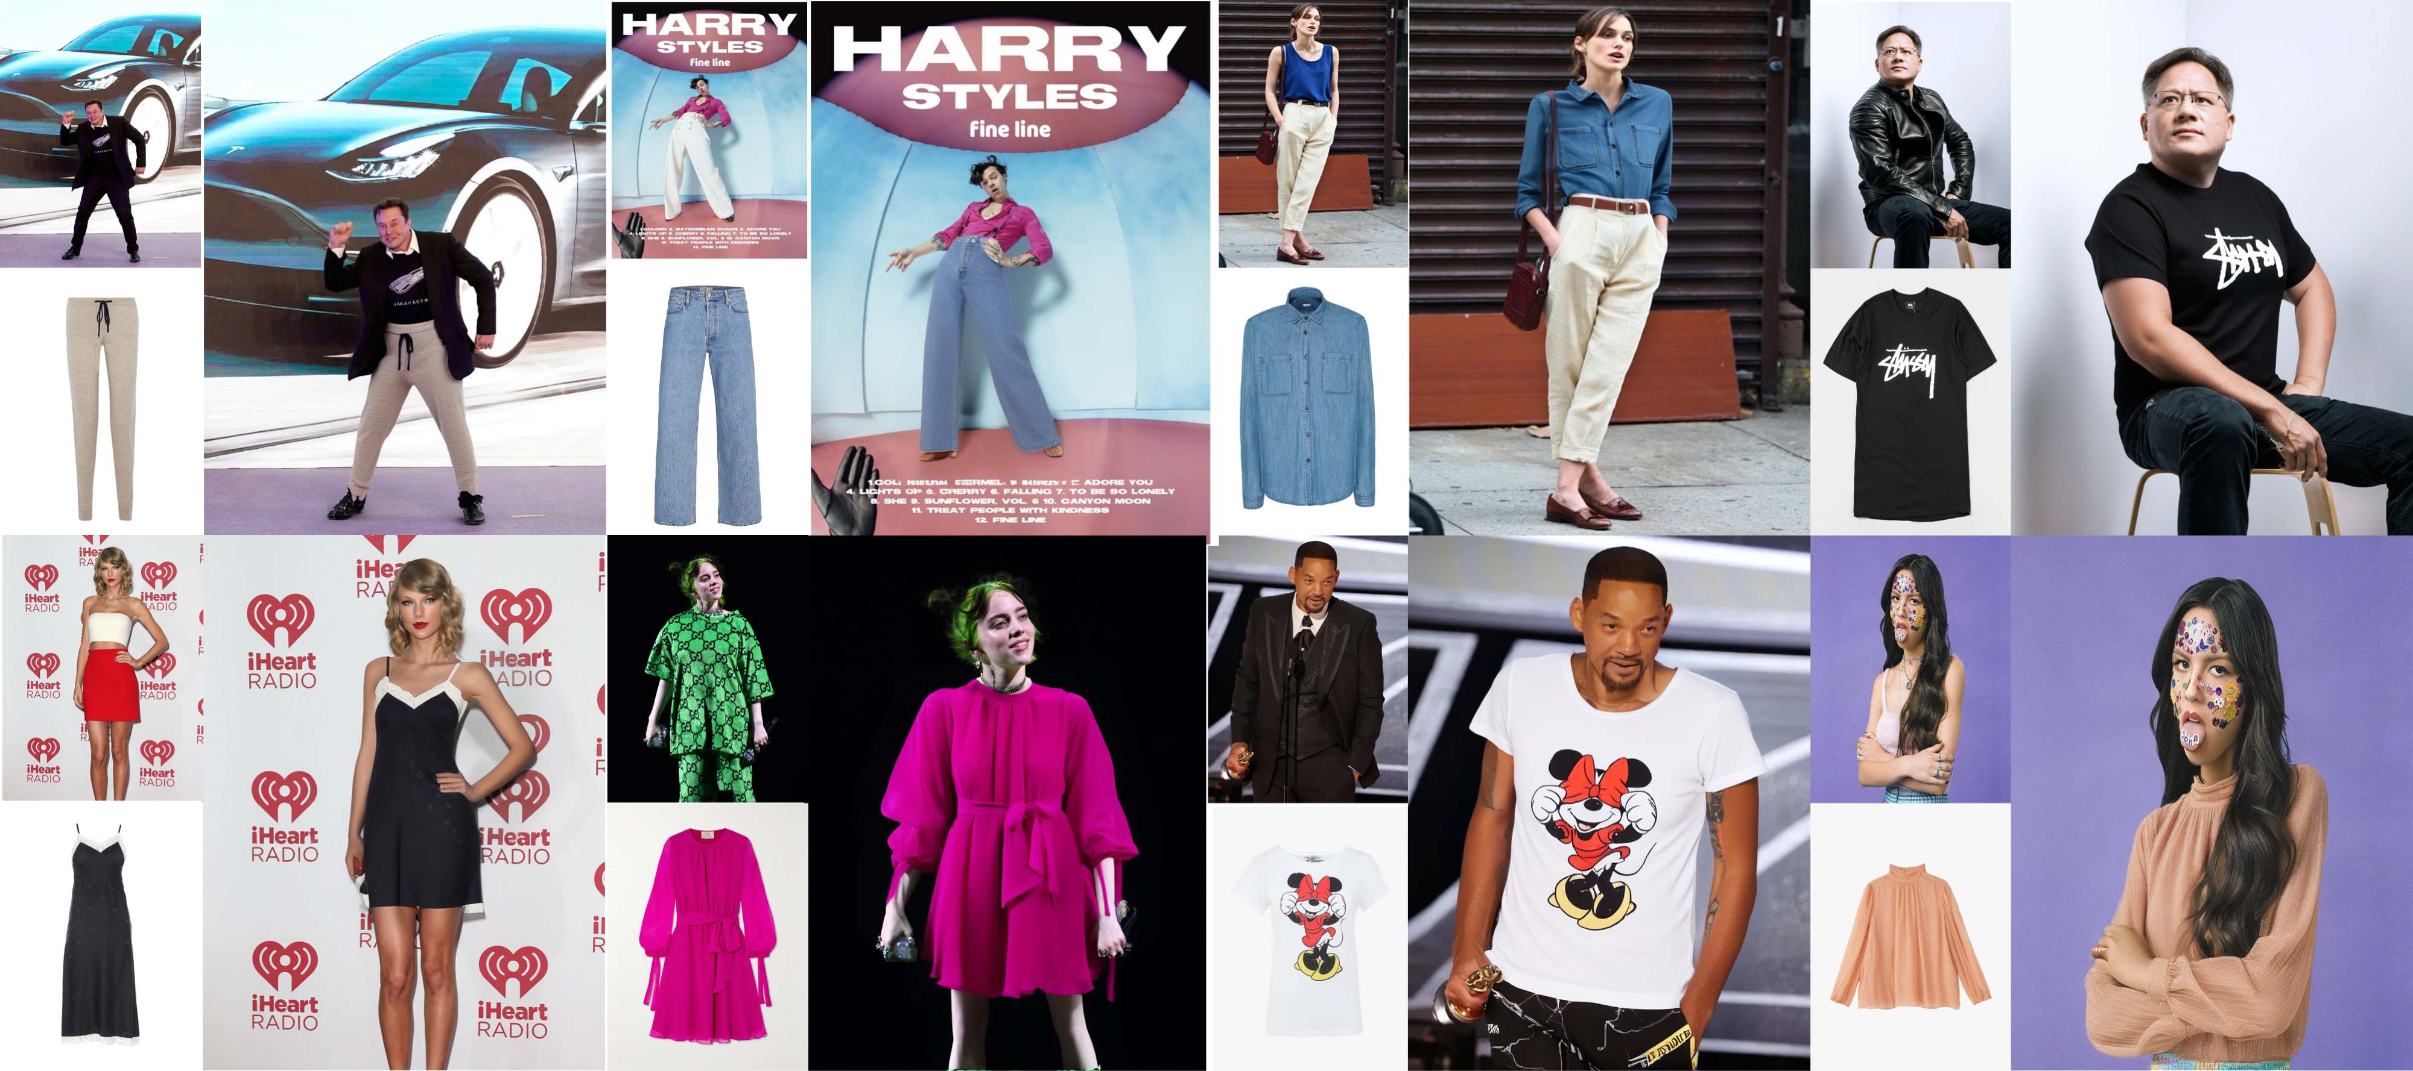
IDM-VTON
https://huggingface.co/yisol/IDM-VTON

Slide 8
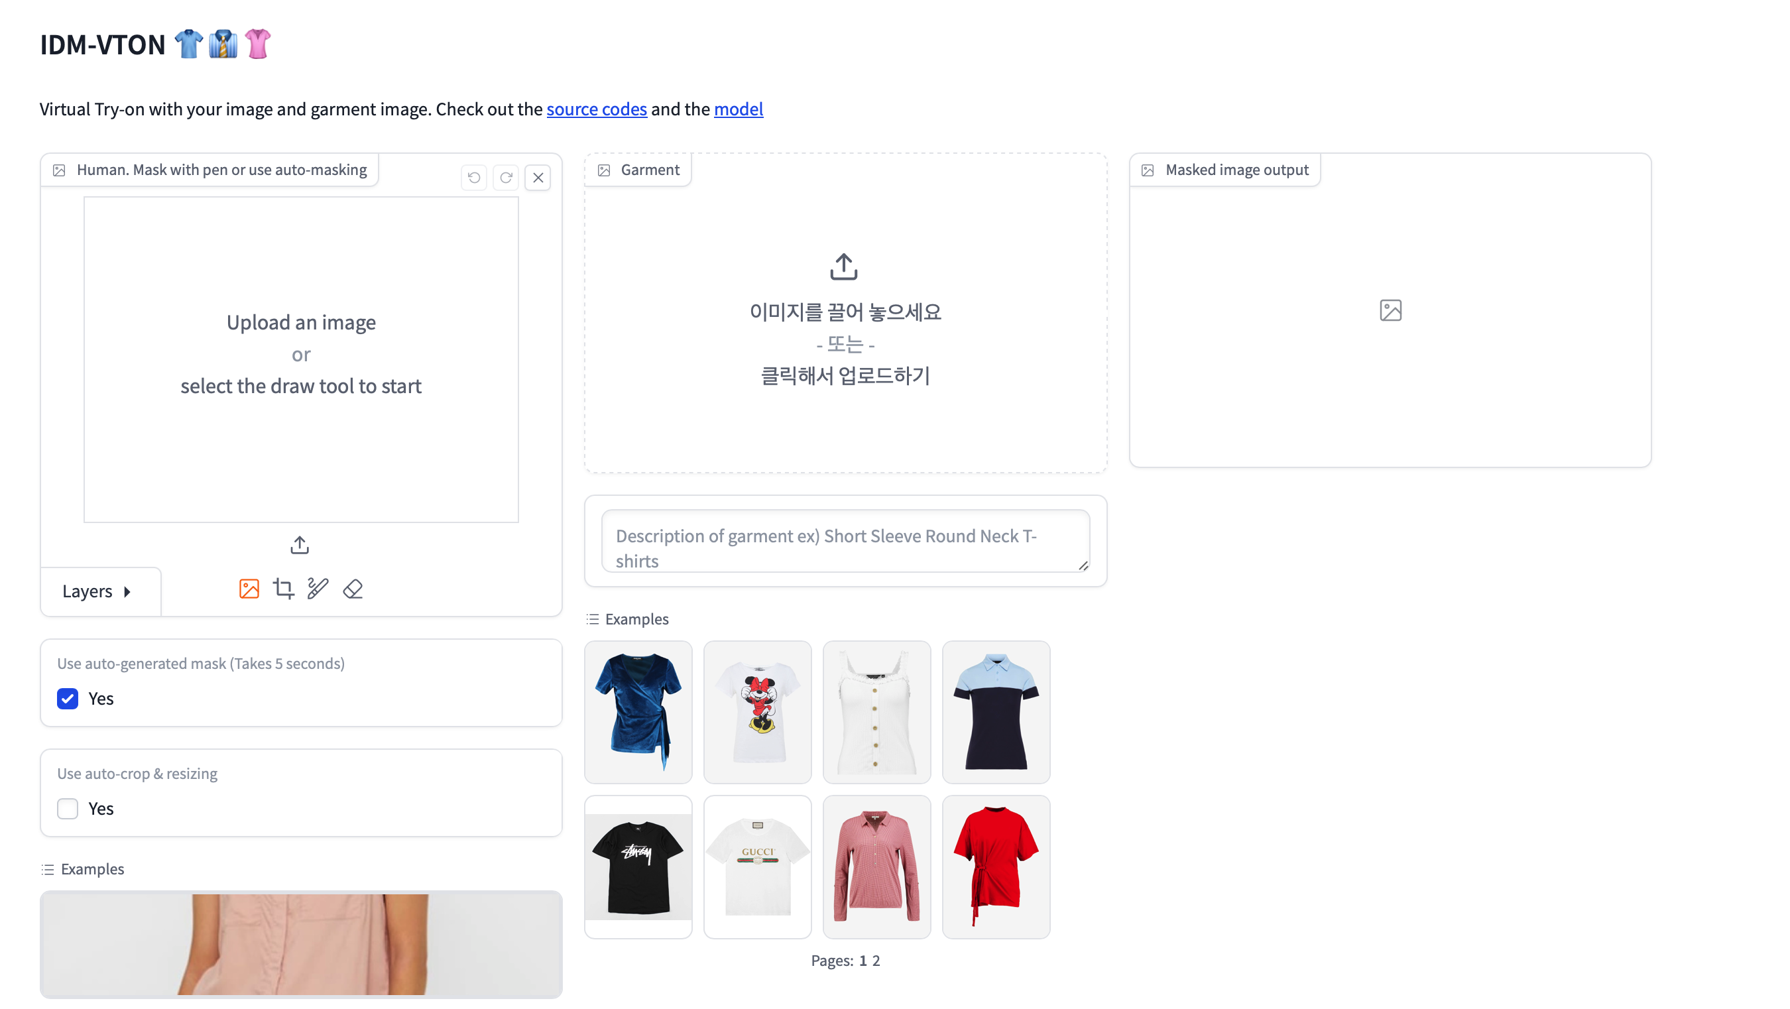
Demo link here IDM-VTON

Slide 9
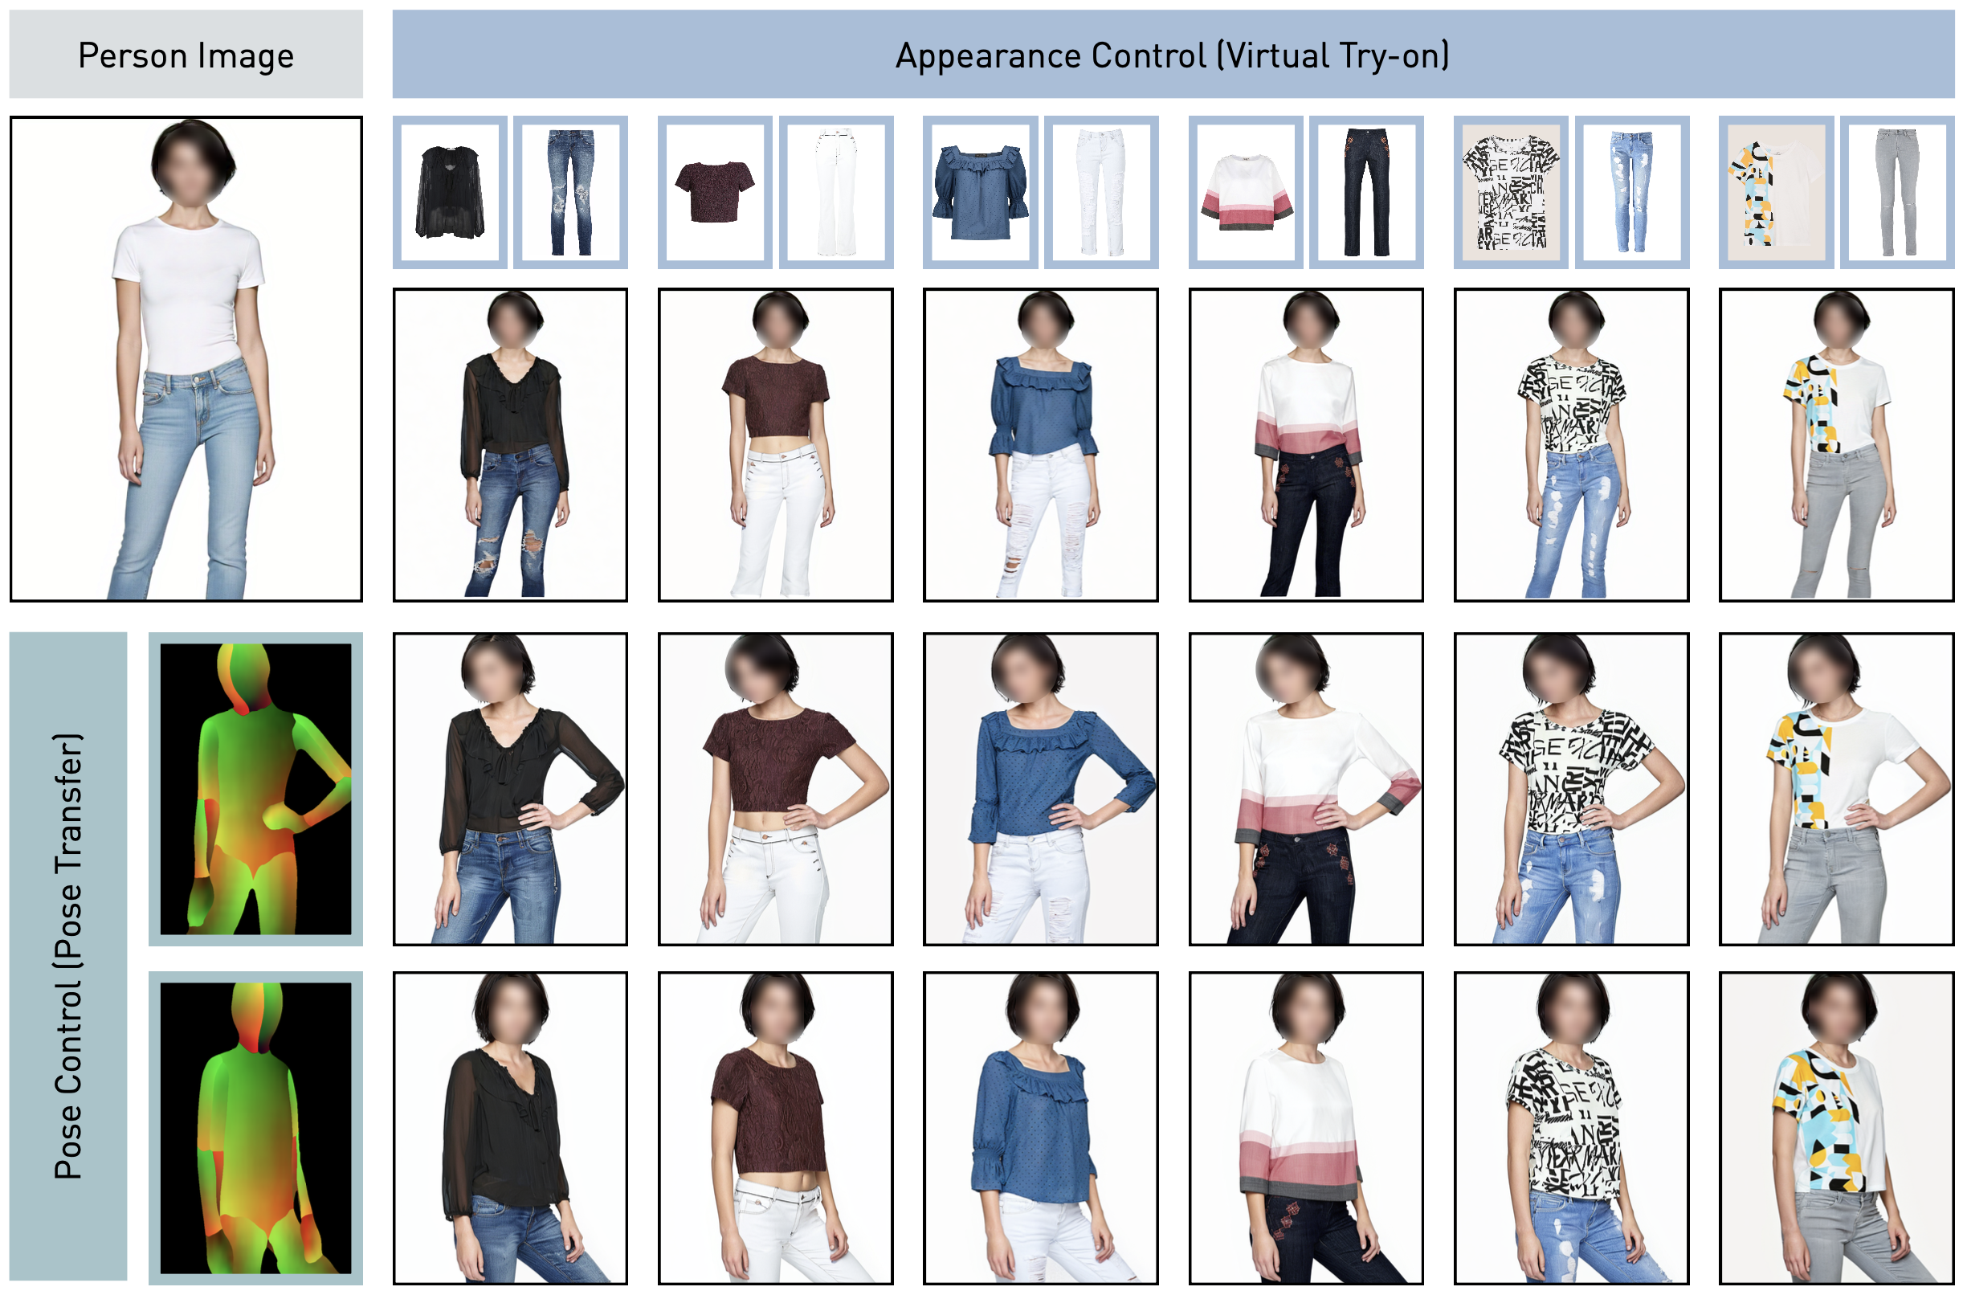
Leffa
https://huggingface.co/franciszzj/Leffa

Slide 10
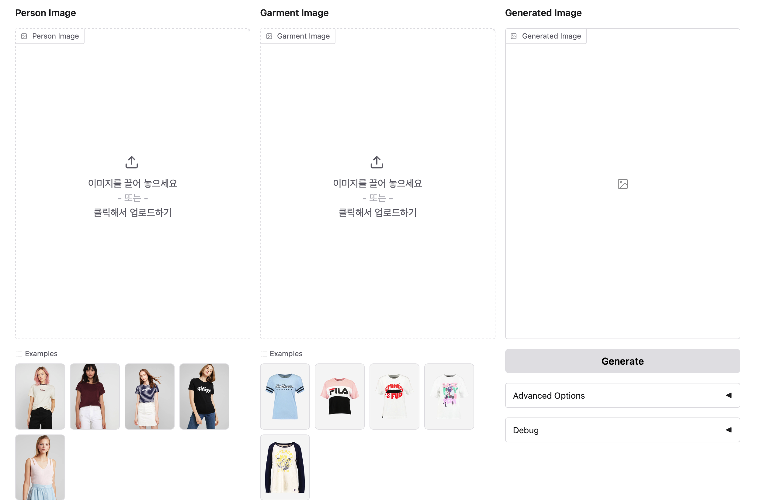
Demo link here Leffa

Slide 11
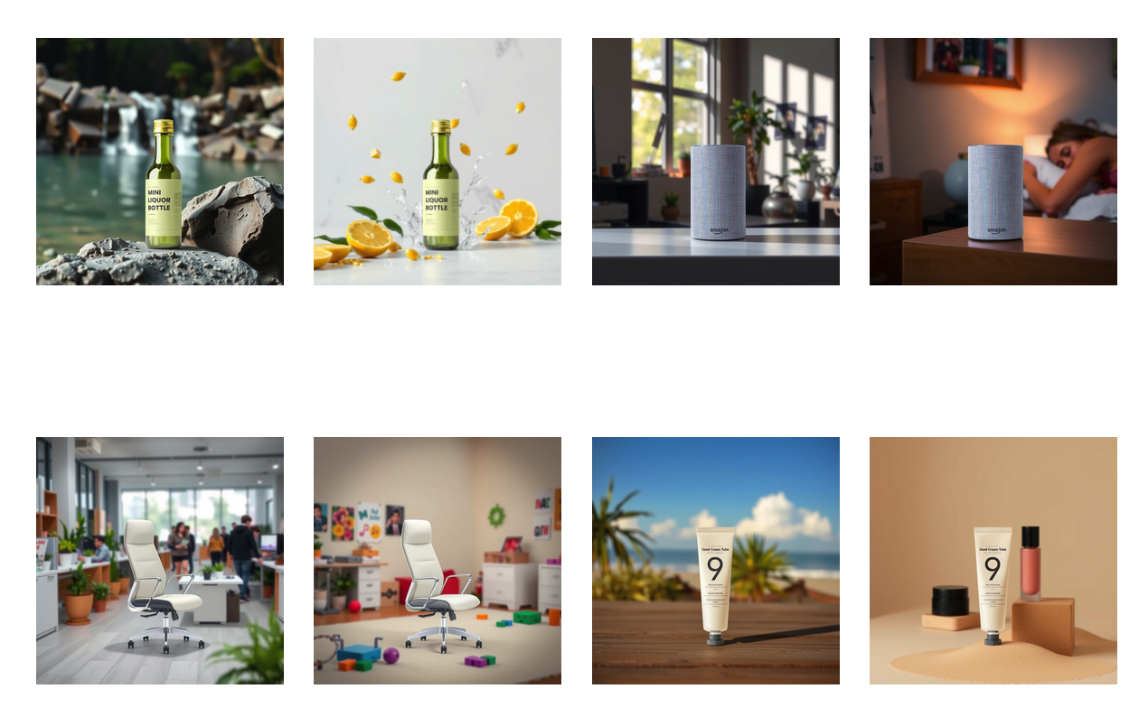
zenctrl_tools

Slide 12
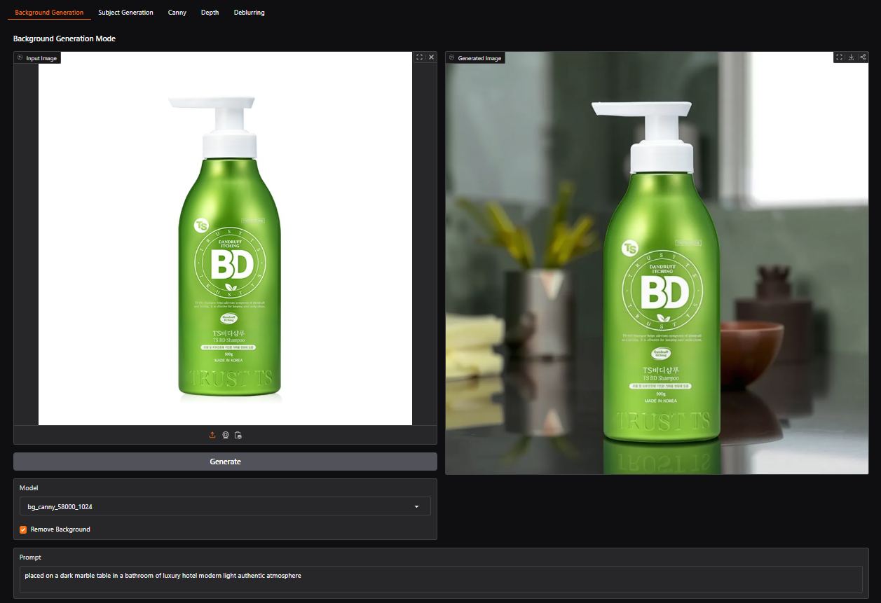
Demo link here zenctrl_tools

